Slide 1
Presentation for Competition
Autonomous System B
Group A
Younsuk Choi
Caio Luiz Candeias Flores
Ukamaka Akumili Anaedu
Pritish Sanjay Samant
Younsuk Choi

Slide 2
Contents
Brief Tapaal Model Explanation
Deep Learning Implementation and Test Result
Younsuk Choi

Slide 3
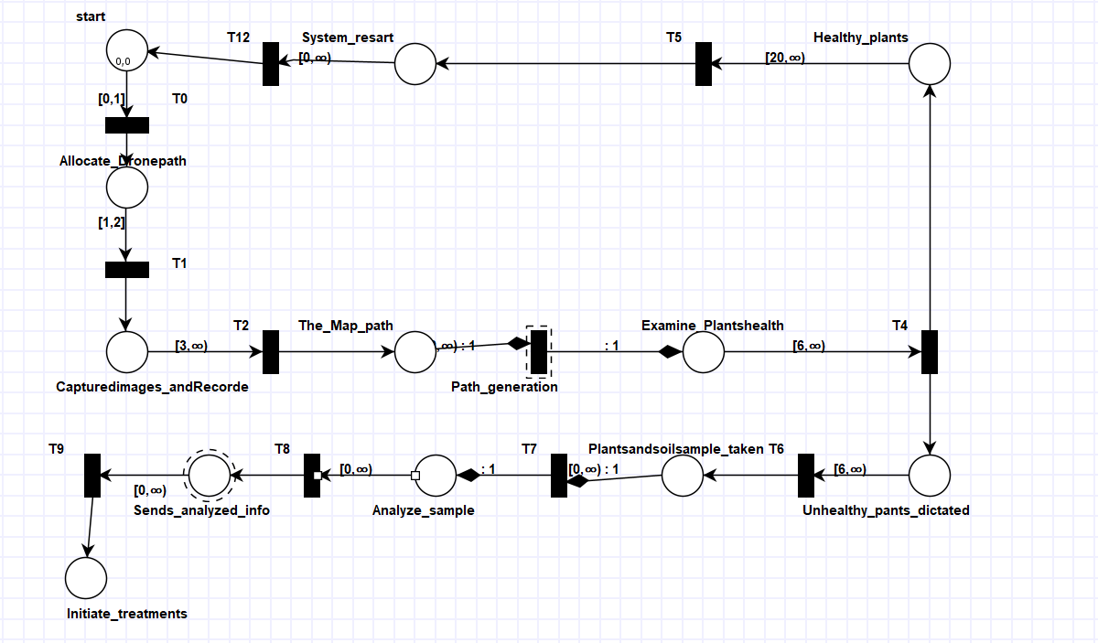
Separate Tapaal Model
The Drone path is being introduced by famer, and then the drone start capturing and recording the data of the images which it will share with the server
Ukamaka Akumili Anaedu

Slide 4
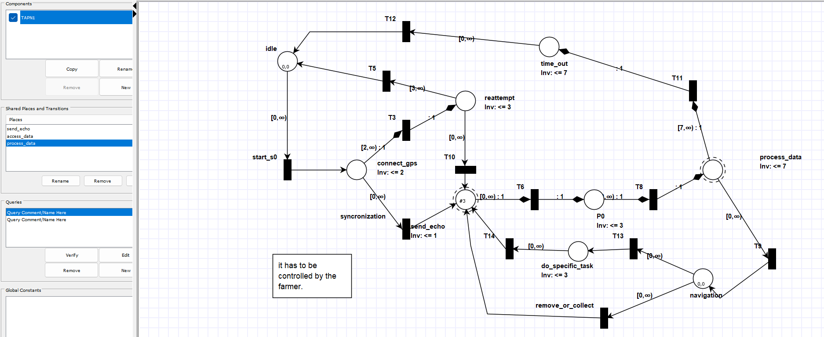
Separate Tapaal Model
The autonomous vehicle is initiated by the famer
and
establish a connection with the Drone in the field and sends the acquired data to the server
Ukamaka Akumili Anaedu

Slide 5
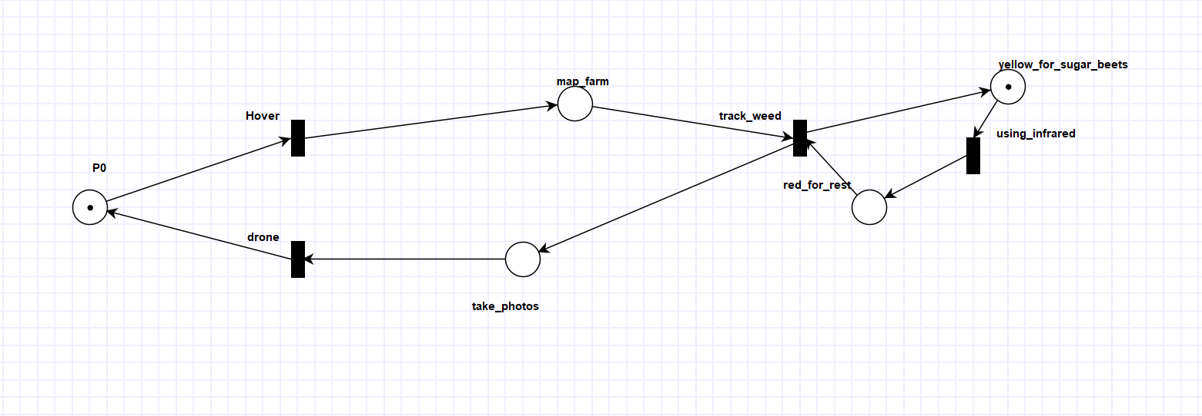
Separate Tapaal Model
This is the multiple drones which also detects weed and spray on the weed too when the famer actives the drone
Ukamaka Akumili Anaedu

Slide 6
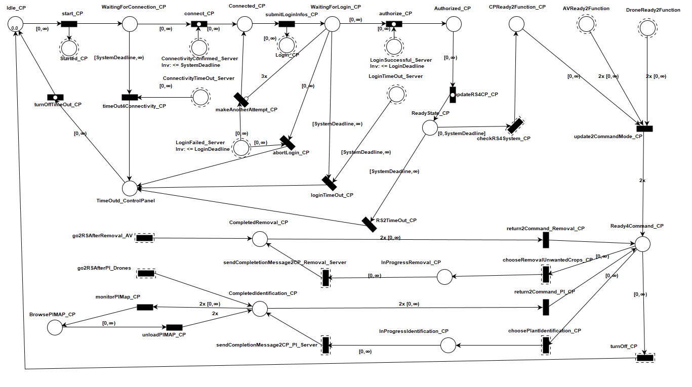
Comprehensive Tapaal Model
Component_Farmer_Control Panel
Younsuk Choi

Slide 7
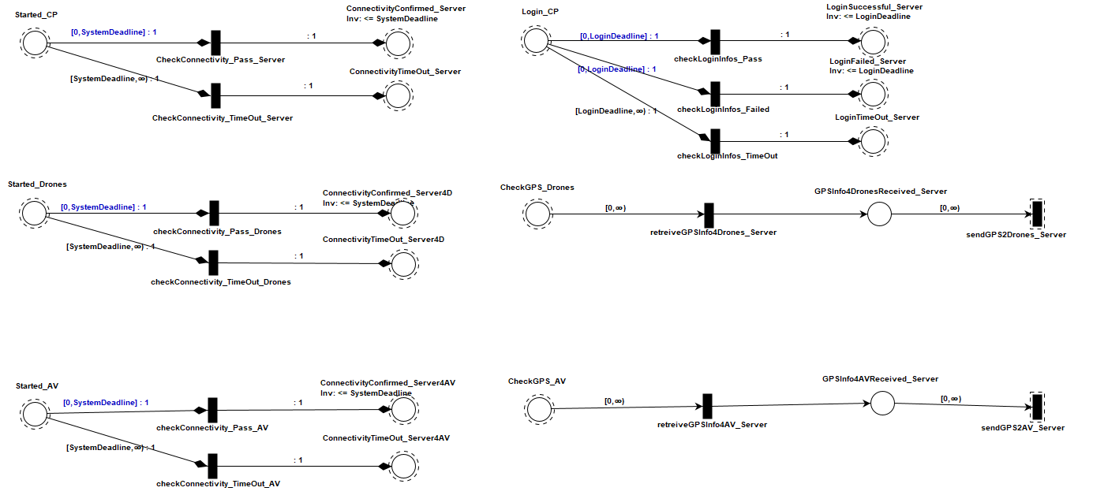
Comprehensive Tapaal Model
Component_Initialization Server
Younsuk Choi

Slide 8
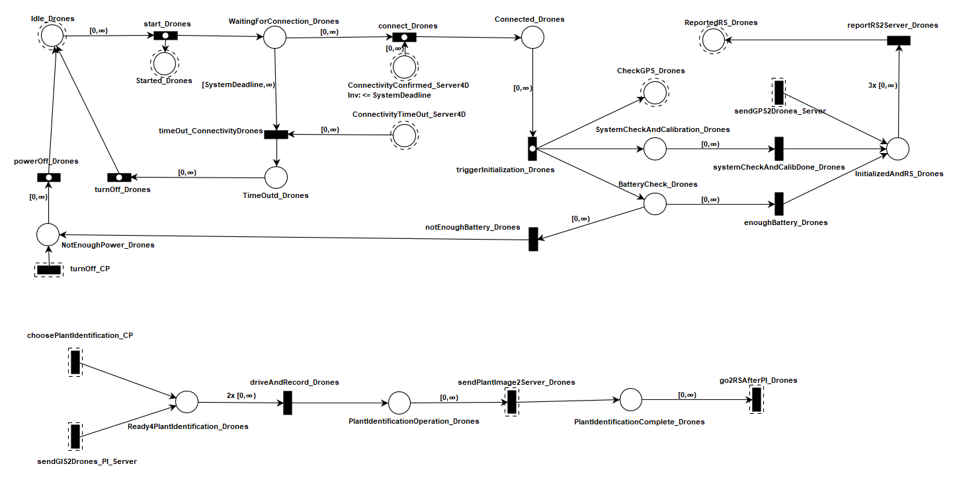
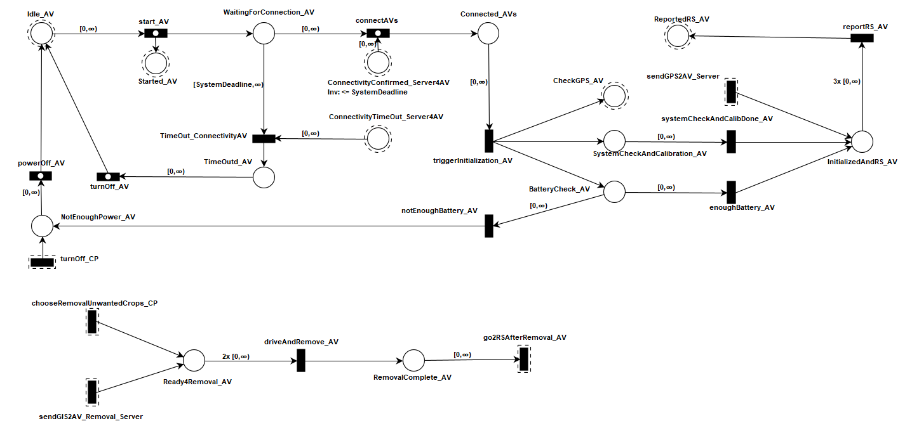
Comprehensive Tapaal Model
Component_Autonomous Vehicles
Component_Drones
Younsuk Choi

Slide 9
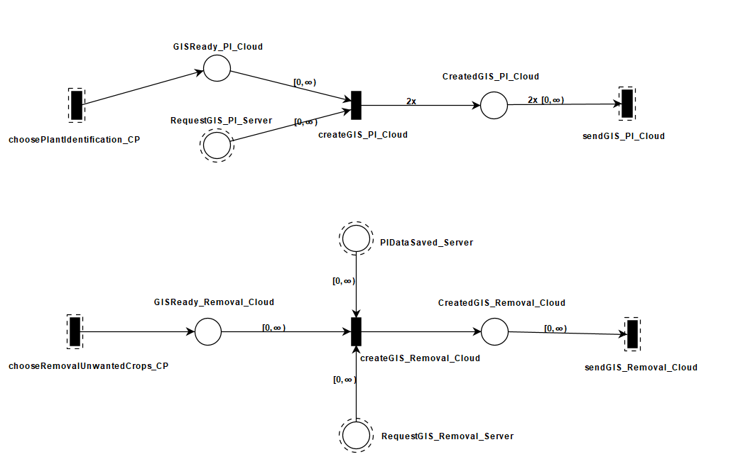
Comprehensive Tapaal Model
Component_Cloud
Younsuk Choi

Slide 10
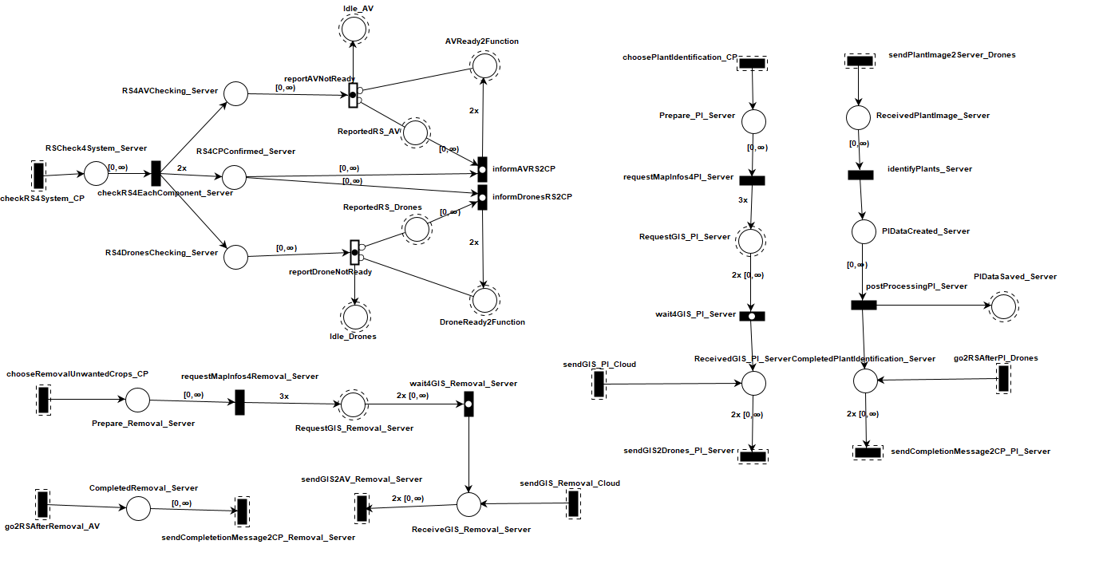
Comprehensive Tapaal Model
Component_Function_Server
Younsuk Choi

Slide 11
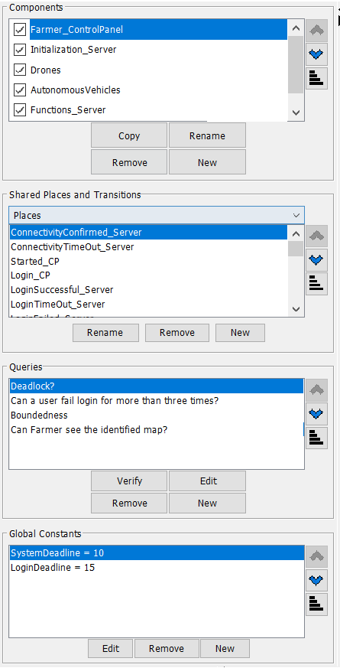
Comprehensive Tapaal Model
Deadlock?
Boundness of a place
Boundness of the system
Liveliness and Reachability
WorkSpace View
Younsuk Choi

Slide 12
Trained Deep Learning Model
FastAi/ResNet Model and variants
Multi classification
Binary classification (Weed vs Not Weed)
Binary classification extracted images from the video
Lenet Model
Younsuk Choi

Slide 13
Topics to talk about for each model
Algorithm used for each model (ResNet50,FastAi, LeNet)
Validation and verification datasets
Freeze, unfreeze and learning rate
Younsuk Choi

Slide 14
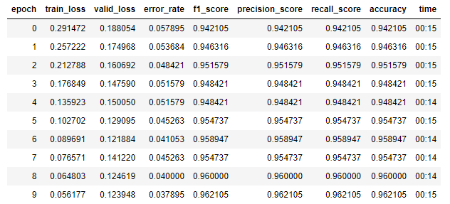
FastAi Model and variants - multiclassification
Caio Luiz Candeias Flores

Slide 15
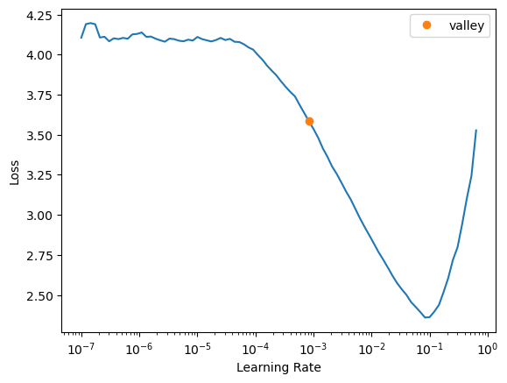
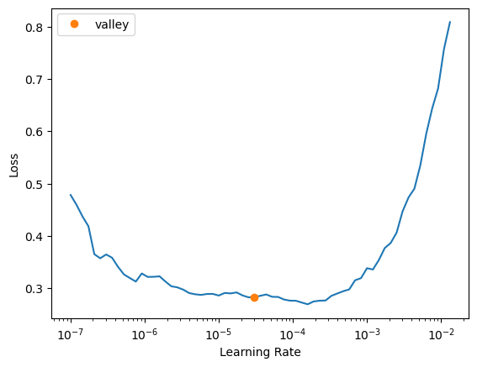
FastAi Model and variants - multiclassification
Caio Luiz Candeias Flores

Slide 16
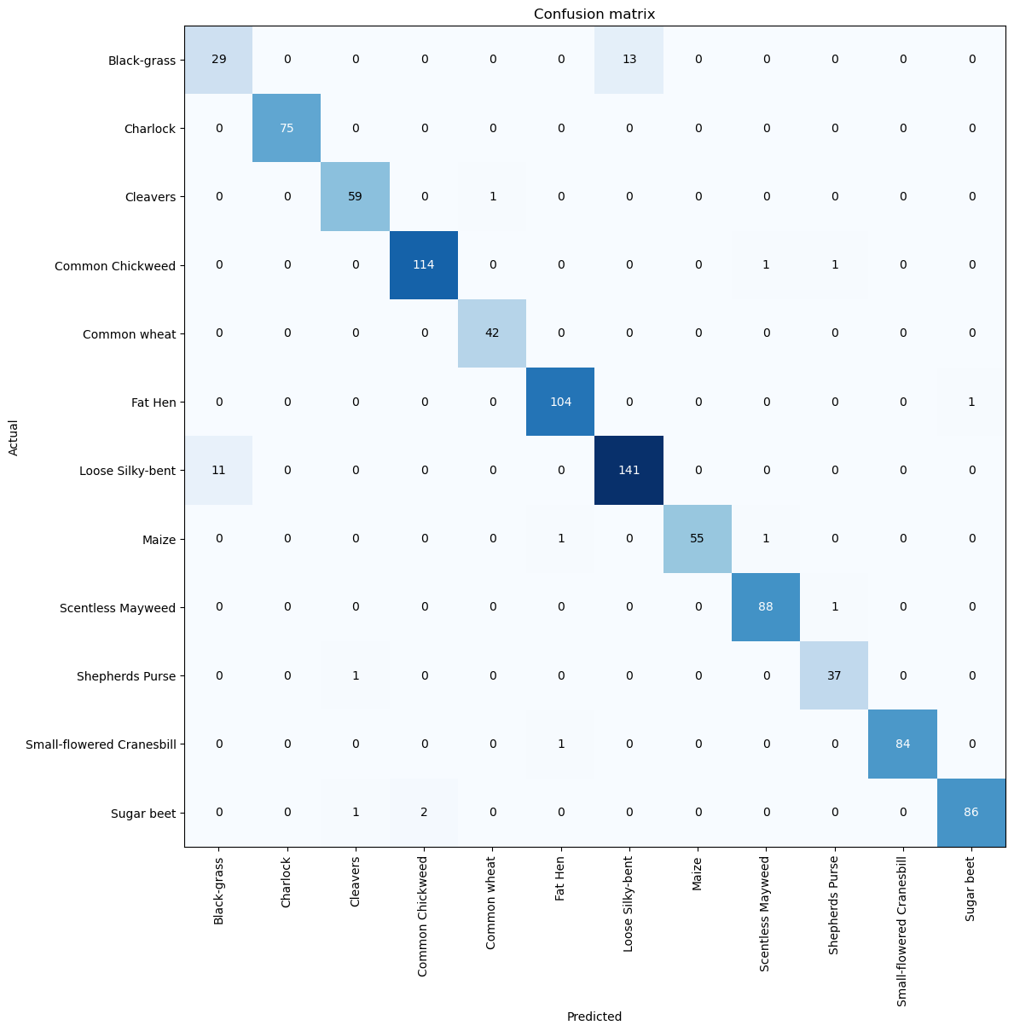
FastAi Model and variants - multiclassification
Caio Luiz Candeias Flores

Slide 17
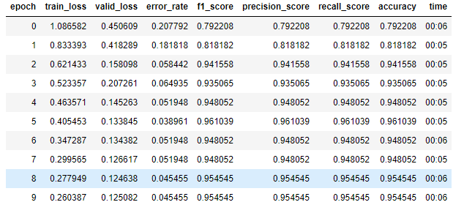
FastAi Model and variants - Binary classification (Weed vs Not Weed)
Caio Luiz Candeias Flores

Slide 18
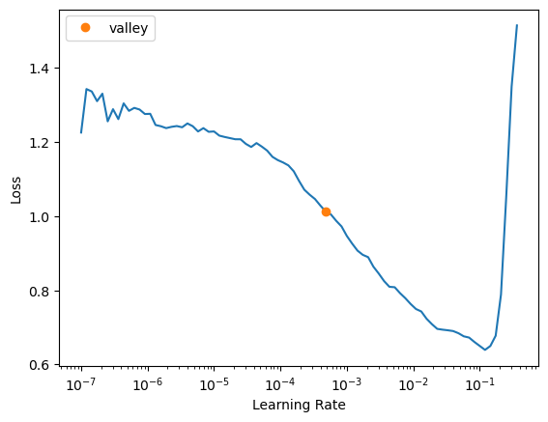
FastAi Model and variants - multiclassification
Caio Luiz Candeias Flores

Slide 19
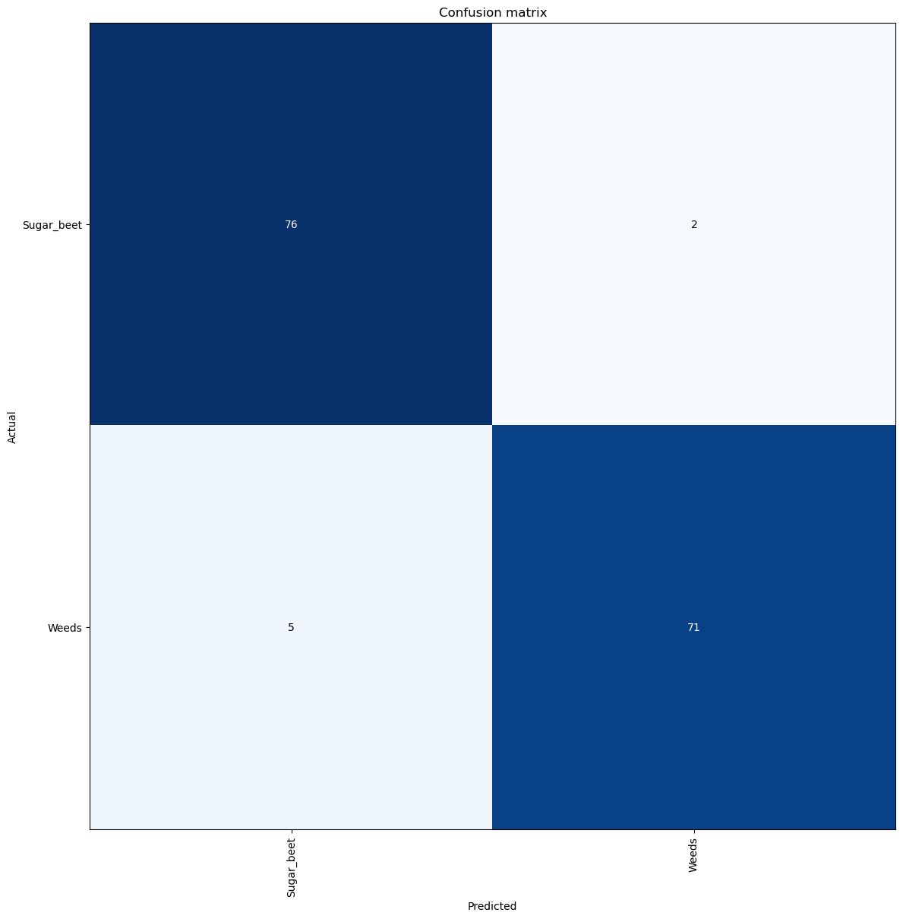
FastAi Model and variants - Binary classification (Weed vs Not Weed)
Caio Luiz Candeias Flores

Slide 20
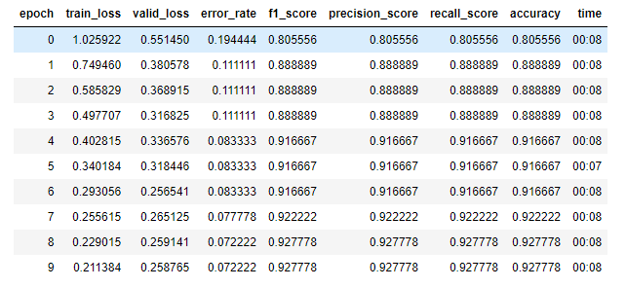
FastAi Model and variants - Binary classification extracted images from the video
Caio Luiz Candeias Flores

Slide 21
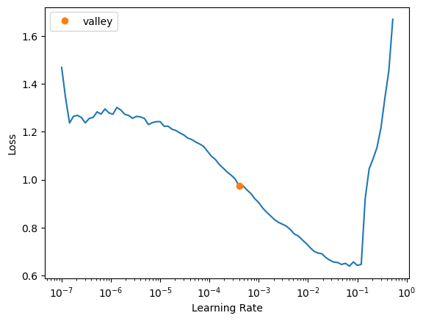
FastAi Model and variants - Binary classification extracted images from the video
Caio Luiz Candeias Flores

Slide 22

FastAi Model and variants - Binary classification extracted images from the video
Caio Luiz Candeias Flores

Slide 23
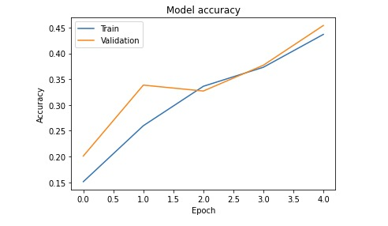
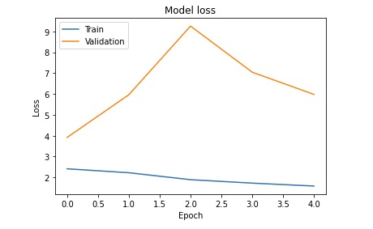
Lenet Model
Pritish Sanjay Samant

